Slide 1


TANZANIA
INVESTMENT FORUM
SEPTEMBER 2014, THE HAGUE
INVESTMENT OPPORTUNITIES
IN ZANZIBAR
ZANZIBAR INVESTMENT PROMOTION AUTHORITY (ZIPA)
1
Notes:
1

Slide 2
OVERVIEW
Zanzibar Profile
Investment Climate
Investment Opportunities
Tourism Attraction
2

Slide 3
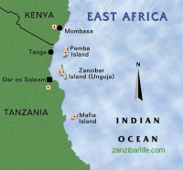
ZANZIBAR PROFILE
An archipelago of two main islands (Unguja and Pemba) and about 50 smaller –islets, lying between 6 and 8 degrees latitude.
A land area of 2332 sq km.
has open culture with a cocktail of African, Arabian and Indian sub continent (swahili culture) predominantly Muslim
Zanzibar City is located about 30 km from Dar es Salaam.

Slide 4
Zanzibar in Figures
Population | 1,303,569 (2012 Census)
Per capita GDP in USD | 667
Inflation | 9.4%
Tourist Arrivals | 181,301 (2013)
Household size | 5.5
Literacy rate | 82.3
Life expectancy at birth | 60

Slide 5
Investment Climate

Slide 6
Attractive Fiscal Regime
Stable and Predictable Fiscal Stability Regime - providing a Soft Landing to all investors. It recognizes that investors need to recover their Investment Costs first before paying corporate tax.
Investment codes give additional incentives to strategic investors

Slide 7
InvestorProtection
Investors in Zanzibar are protected both constitutionally and through international conventions to which Zanzibar, being part of the United Republic of Tanzania, is a signatory.
Bilateral and multilateral international treaties signed include: MIGA - Multilateral Investment Guarantee Agency
ICSID - International Centre for the Settlement of Investment Disputes
Convention for the Protection of Industrial Property and Convention on Recognition and Enforcement of Foreign Arbitration Award and
Double Taxation Treaties with several countries.
These arrangements guarantee the security of FDI against losses arising from armed conflict or international disorder, and protection against nationalization. Further, they ensure transfer of profit, dividends and capital.

Slide 8
Supportive Infrastructure
    Functional Sea Ports
    Airports servicing domestic and international flights
    Road network covering most investment areas
    Considerable ground water resources
    Telecommunication facilities

Slide 9
One Stop Centre
ZIPA - Established under ZIPPA ACT NO. 11 OF 2004,
A government focal point for Promotion and Facilitation of investment in Zanzibar.
A “One Stop Investment Facilitation Center” whereby all investment services to investors are facilitated and provided under one roof.

Slide 10
Investment Record
Currently, ZIPA has approved 581 projects with a proposed capital of US$ 3.2 billion in different sectors.
Tourism, which includes hotels and restaurants, seaports, recreational centers and diving activities, among others, is a leading sector. The sector represents more than 60% of total investment projects.
Summary of approved projects sector wise is provided in the table below:

Slide 11
APPROVED PROJECTS – SECTORWISE

Slide 12
Investment by Region: The leading (Capital)

Slide 13
INVESTMENT OPPORTUNITIES

Slide 14
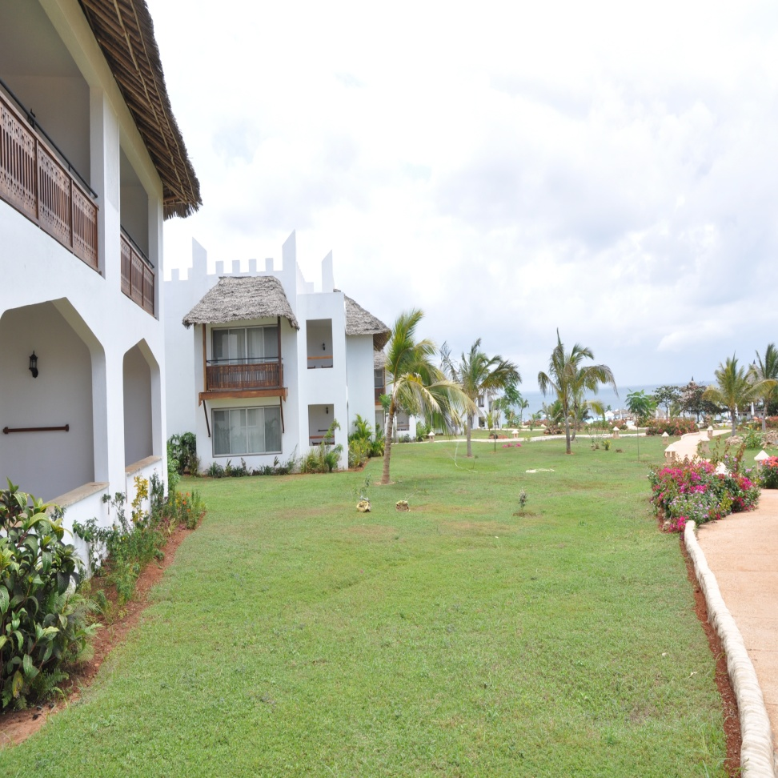
Tourism Sector
Hotels and Modern Restaurants i.e
Establishment of specialized cuisine restaurant (joint venture arrangement)
Development of up-market/high class chain hotels.
Emphasis in eco–tourism

Slide 15
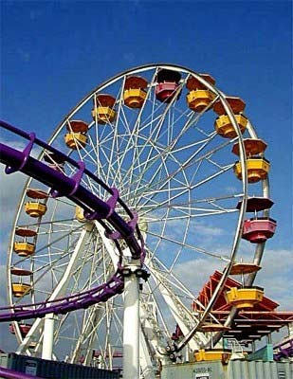
Tourism Sector…
Conference Tourism and Amusement Park i.e
  Establishment of Conference and Convention Centers;
  Investment in Amusement Parks at Fumba and Micheweni

Slide 16
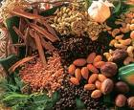
Agriculture
    Flower production (in green houses)
    Vegetable production through hydroponics system techniques
    Fruit farming, processing and canning
    Exportation of fresh fruits which include orange, rambutan and mango
    Agro processing and value addition

Slide 17
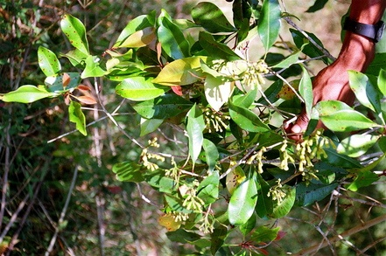
Spices
For centuries “the Spice Islands” (Zanzibar) has exported quality exotic home-grown spices to world market. This sector offers great potential for expansion and the creation of forward linkages through value addition. These traditional spices include:
Cloves – our famous spice export
Cinnamon, cardamom, nutmeg, black pepper, chillies and many more
Untapped opportunities are the ‘value addition’ and processing by-productssuch as perfumes, perfumed soap, medication, and food processing items.

Slide 18
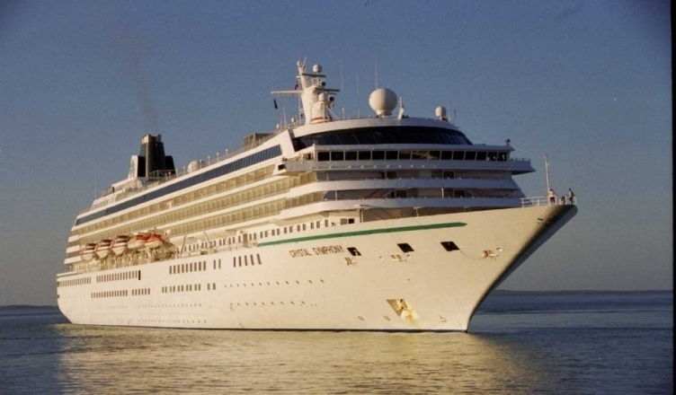
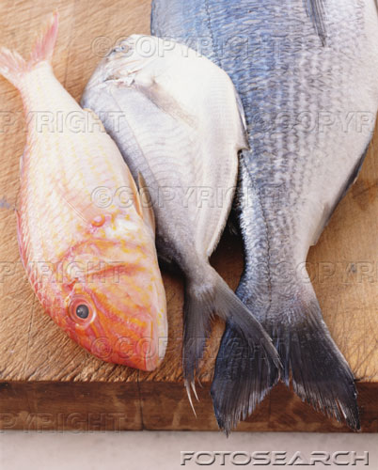
Fisheries
Opportunities in Fisheries:
Deep Sea Fishing
Fish Processing & Canning
Aqua/Mari culture (fish farming and seaweed production).

Slide 19
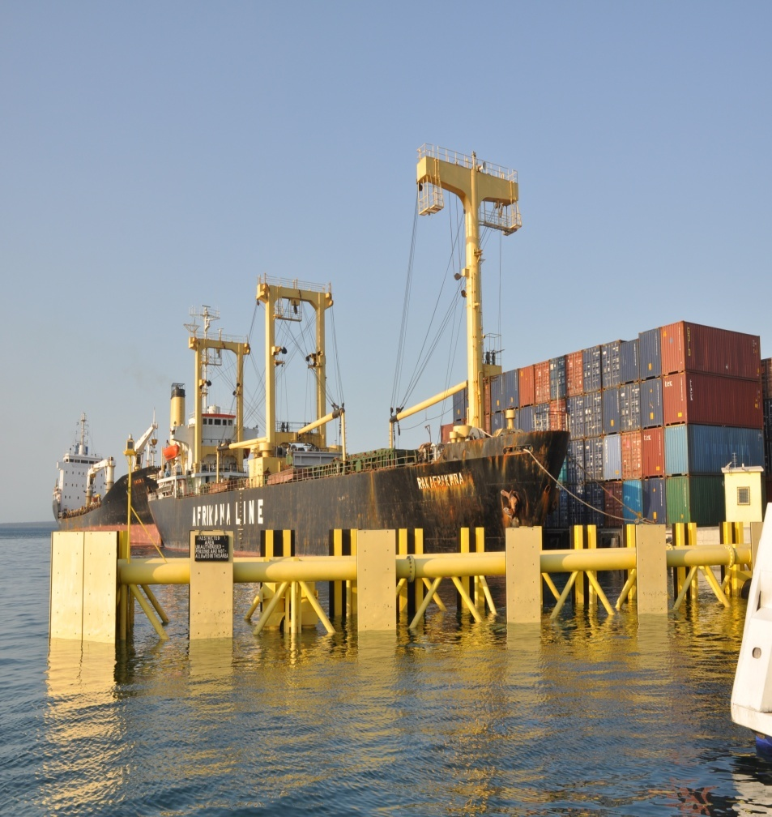
Infrastructure Development
Sea Port Development:
Development and construction of new modern Commercial Port at Mpigaduri area under concession arrangements are encouraged by the Government.
Renewable Source of Energy:
Potential investors are encouraged to invest in power (electricity) using alternative eco friendly sources.

Slide 20
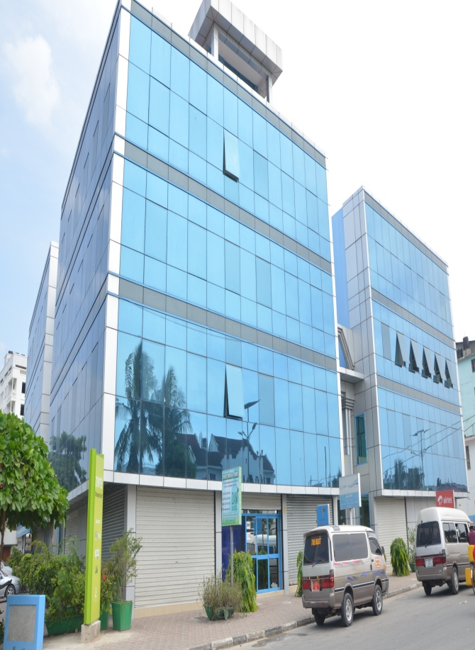
Service Sector
Health care centres
Education
Business & Financial services
Information and Communication Technology
Establishment of Specialized Hospitals, diagnostic centers and nursing home
Establishment of Specialized Modern Colleges for Hotels and Tourism Management
20

Slide 21
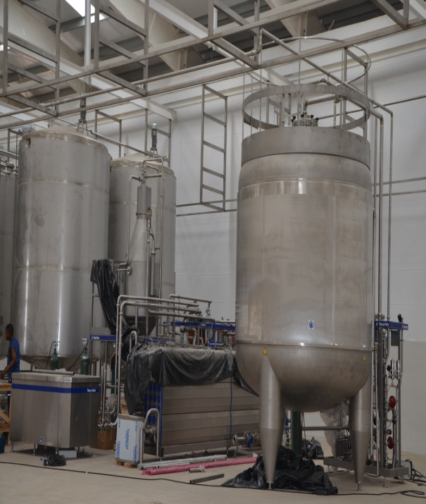
Free Zones Opportunities
Export Processing Zone & Free Port Zones
Amani Industrial Park
FumbaEPZ,
Micheweni EPZ
Maruhubi Free port and
Airport Free port zone
Opportunities include:
Infrastructure Development at the zones
Provision of services
Investing within EPZ (textiles, furniture, assembly)
More opportunities at Fumba includes construction of industrial sheds, Real Estate Development and Development of Mini cities.

Slide 22
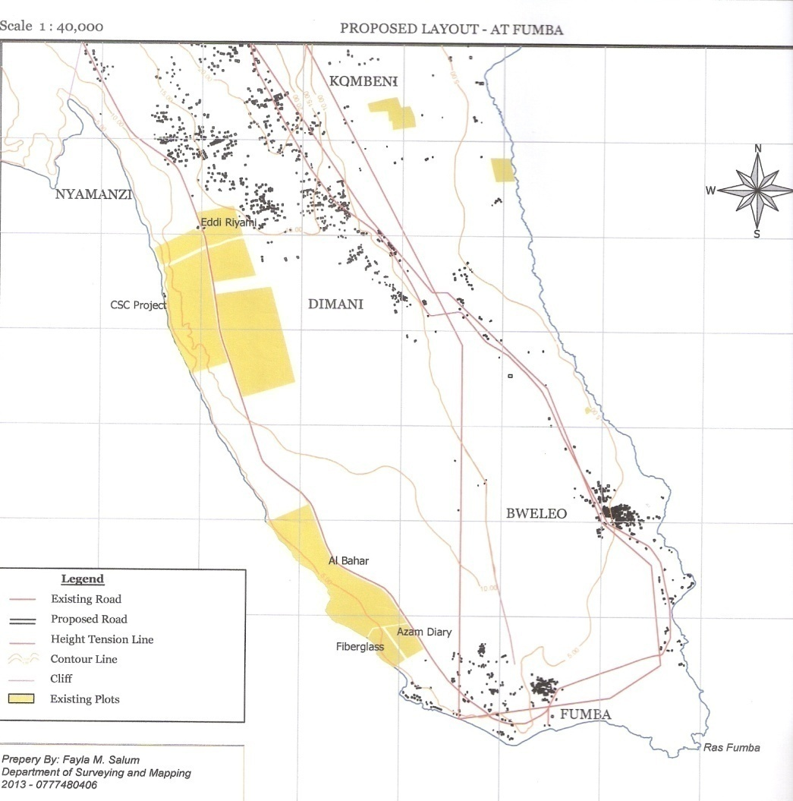
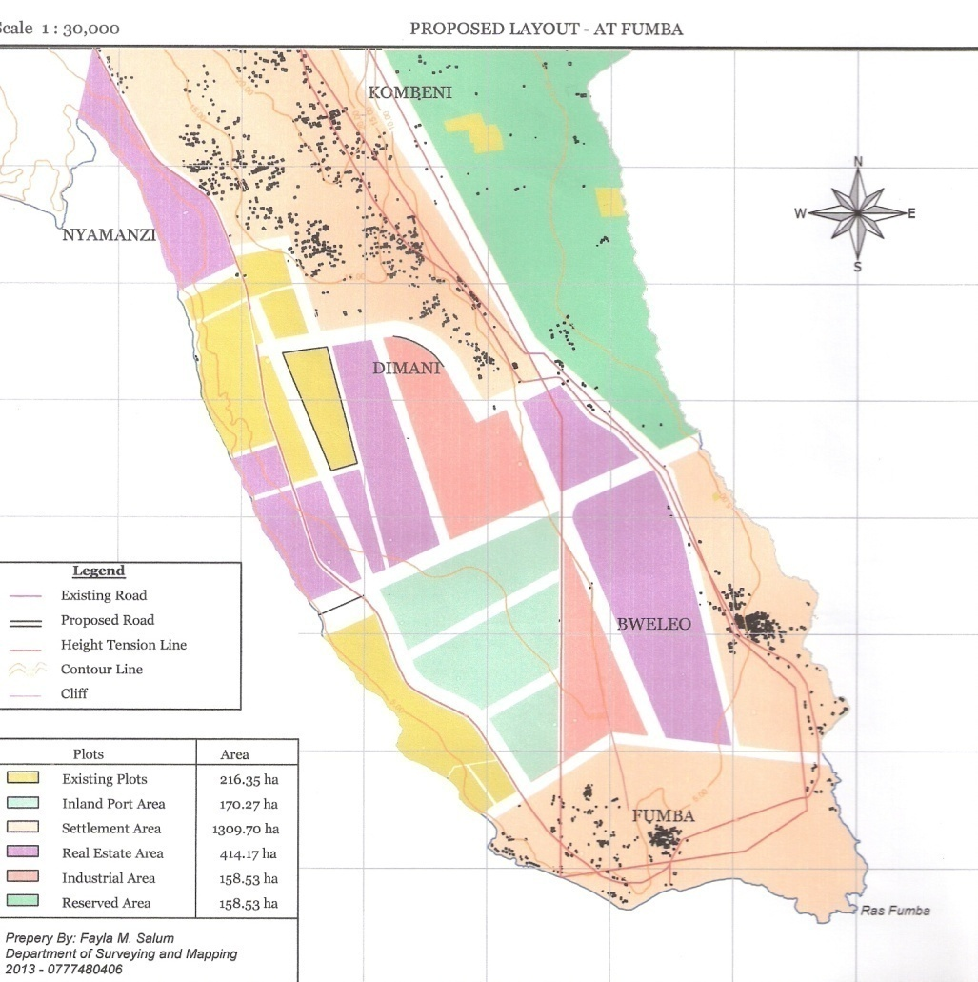
Fumba Land Use Plan

Slide 23
Tourism Attractions
      Historical Site Visits
      Ecological Life Experience
      Sports Performance Tourism
      Culture and Adventures
      Holiday Tourism

Slide 24
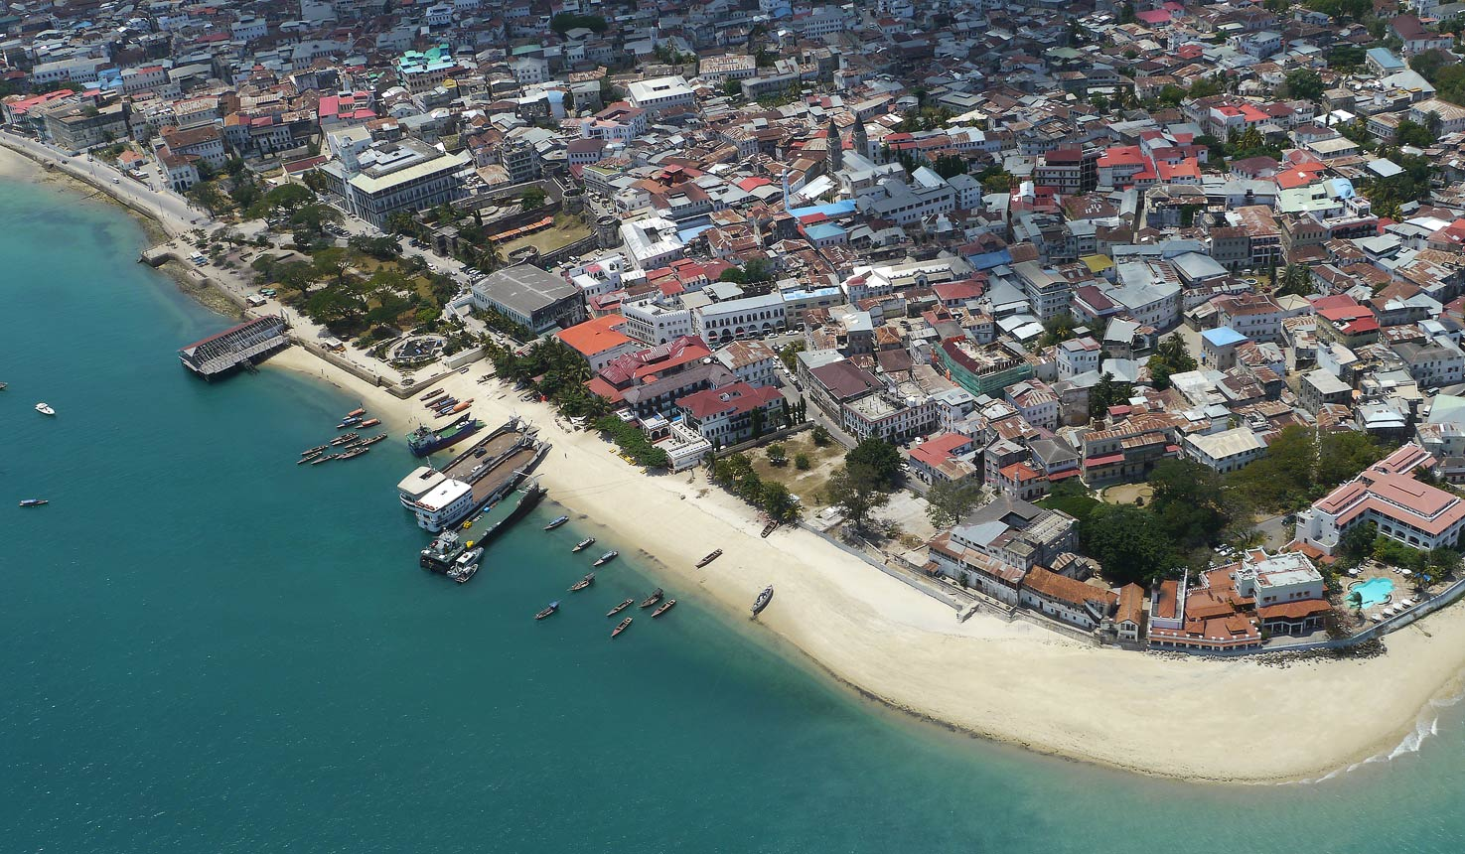
Historical and Heritage,
Stone town declared a World heritage Site by UNESCO. It is the old city and cultural heart of Zanzibar, little change in the last 200 years

Slide 25
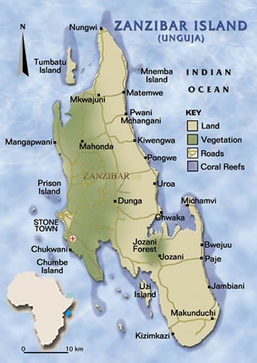
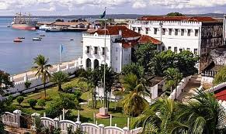

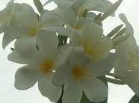
Zanzibar “The spice island”
Unguja set like a jewel in the warm and tranquil coral waters of the Indian Ocean. It is about 15minutes flight from Dar es Salaam and about 75 minutes flight from Kilimanjaro, are the legendary islands of spices, fragrances, flowers and fruits.

Slide 26
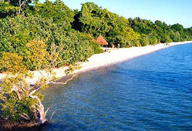
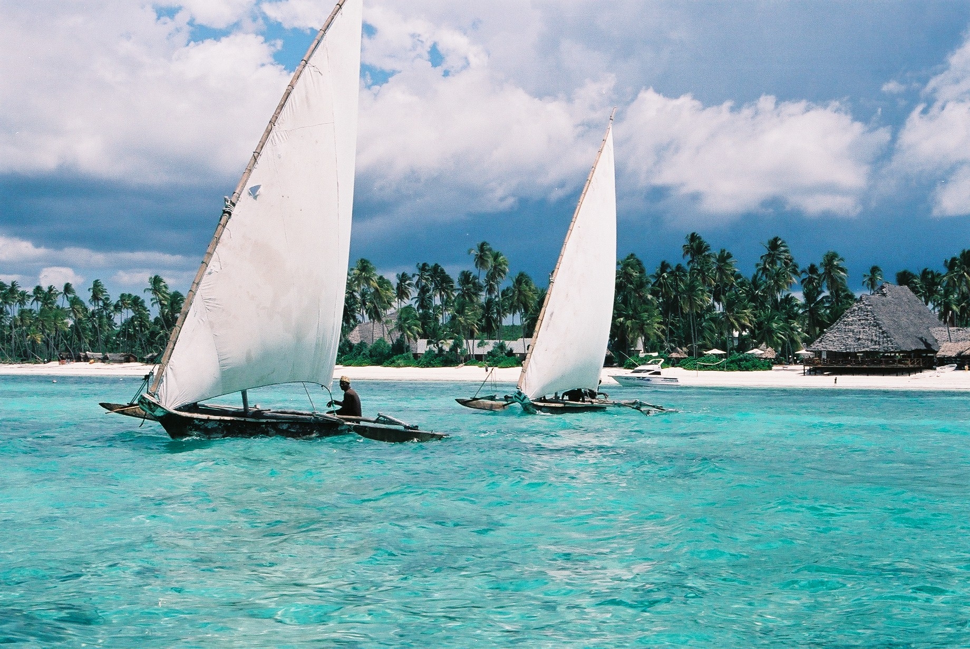
Pemba Island “Clove Island”
Located about 80km from Zanzibar Island, with its hilly landscape its highest point is less than 100 metres above sea level,
Its wealth of natural resources ranging from beaches to mangrove ecosystems to natural forests.
The coral reefs surrounding the island protect a massive amount of marine species and offer some of the best diving spots in the world

Slide 27
CONTACT:
EXECUTIVE DIRECTOR
ZANZIBAR INVESTMENT PROMOTION AUTHORITY
(ZIPA)
P.O.BOX 2286
ZANZIBAR - TANZANIA
TEL: 255 24 2237353
FAX: 255 24 2232737
EMAIL: zipa@zanzinet.com
zipaznz@zanzinet.com
WEBSITE: www.zanzibarinvest.org

Slide 28
Zanzibar
A place not to miss in your lifetime
Welcome for Investment and
Enjoy its Hospitality

